Slide 1
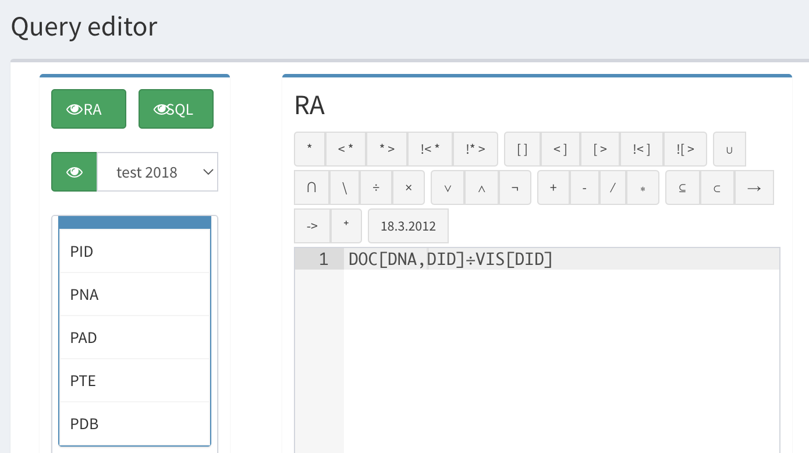
Lab 4
RA in examples

Slide 2
RA Testing schema connection
Relational algebra queries tool translates queries into SQL
Developed as FIT CTU students
Still updated
https://dbs.fit.cvut.cz/
GO TO→ Connections → New database connection (left column)

Slide 3
How to connect the doctor database
DB Connection
Connection name = RA Testing schema
DB Type = ORACLE
Host = oracle.fit.cvut.cz
Login = doctor
Port = 1521
SID = ORACLE
Press Add Connection
Choose DB Schema doctor
put password: ra_testing
IMPORTANT: check "read-only" box
Connect

Slide 4
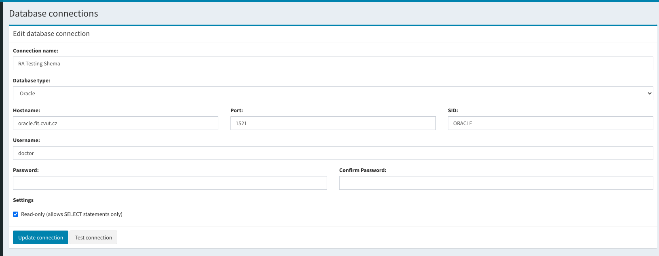
Connection example

Slide 5
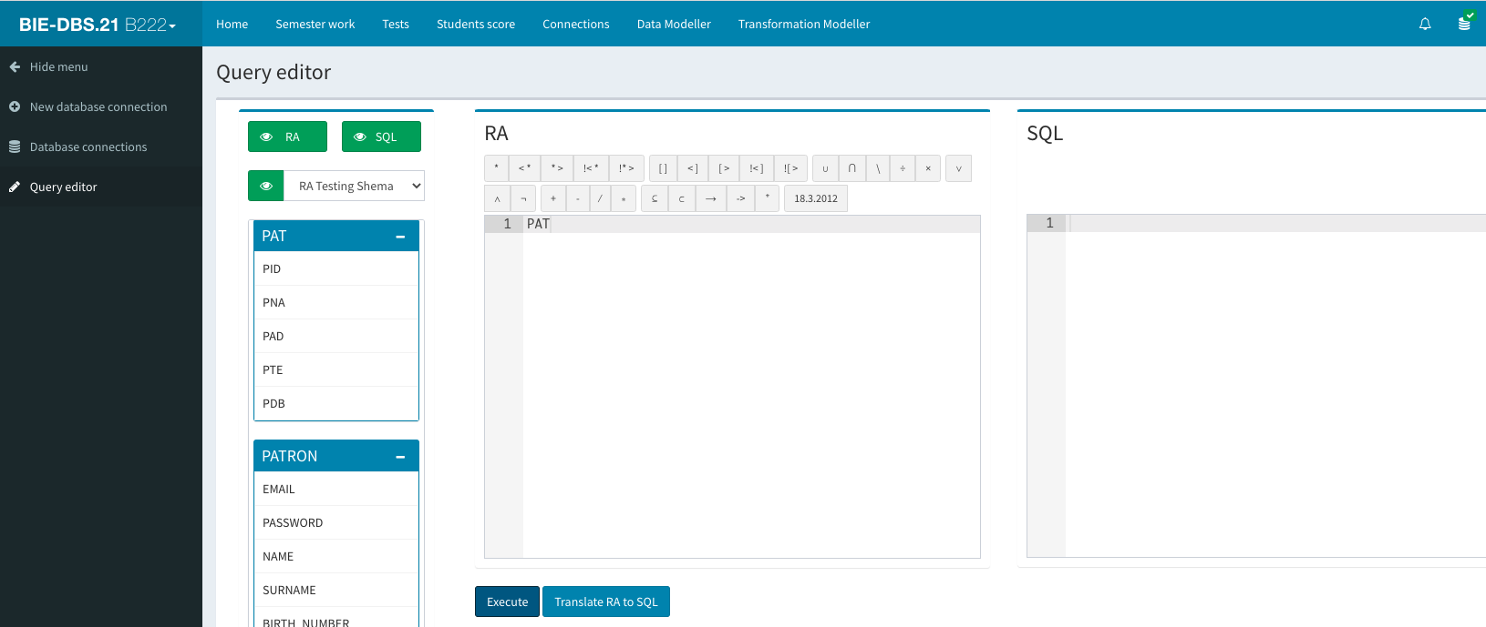
Open query editor

Slide 6
Lets go to the solve next queries
List of all doctor's specializations.
DOC[spe]
Names of all ‘orthopeds’
DOC(spe='orthoped')[dna]
Names and addresses of all patients born before 1920 (suppose date attributes in format DD.MM.YYYY). -> use format: PDB<'01.01.1920'
PAT(PDB<'01.01.1920')[PNA,PAD]
DID's of doctors visited by patient Scott.
{PAT(pna='SCOTT')* VIS}[did]
Names of internists visited by patient Scott.
{{PAT(pna='SCOTT') * VIS }* DOC(spe='internist')}[dna]
Names and addresses of patients visited by doctor Jones
{PAT * {VIS* DOC(dna='Jones')} }[pna,pad]
Names and address of patients visited only by doctor Jones (i.e. by no other doctor).
{{PAT * {VIS* DOC(dna='Jones')}}[pna,pad] } \{{PAT * {VIS* {DOC(dna!='Jones')}}}[pna,pad] }

Slide 7
Harder queries
Pairs of names of patients living in the same address.
{{PAT[pid->id1,pna->name1,pad->address1] × PAT[pid->id2,pna->name2,pad->address2]}(address1=address2 ∧ id1!=id2)}[name1,name2,address1]
The names of doctors who already had patients
{VIS*DOC}[DNA]
Names of doctors who have no patients yet.
{ VIS!*>DOC} [DNA]
Names and addresses of patients with diagnose D3 or D4 (do not use a natural join for this query)
{ VIS!*>DOC}[SPE]

Slide 8
Harder queries
The patients who visited any doctor.
PAT<*VIS
The patients who visited all doctors.
PAT*{VIS [PID, DID]÷ DOC[DID] }
The patients who did not visited each doctor. Including the patients without visits.
PAT[PNA] \{{PAT*VIS} [PNA, DID]÷ DOC[DID]}
The patients who visited at least one othoped. = the patients who visited any orthoped
{PAT*{VIS*DOC(SPE='orthoped')}}[PNA]
The patients who did not visited any orthoped.
{PAT!<*{VIS*DOC(SPE='orthoped')}}
The patients from address „Pardubice“ who visited each orthoped (can return 0 tuples)
{PAT(PAD='Pardubice')*{VIS*DOC(SPE='othoped')}} [PNA,DID]÷DOC(SPE='orthoped')[DID]

